Slide 1
Automatic Order Retrieval System
Group 9
F. Cumpa
A. Delfin
M. Samalo
Z. Zhang
November 20th, 2015
Notes:
SLIDE 1

Slide 2
Outline
Project Objective
Motivation
Literature Review
System Design
Hardware
Software
User Interface
Conclusion
November 20th, 2015
Notes:
SLIDE 1

Slide 3
Project Objective
Design and construct a fully automated order retrieval system that is able to retrieve items from shelves and place them into a container in order to minimize labor cost and human errors.
November 20th, 2015
Notes:
SLIDE 1

Slide 4
Motivation
Locating and retrieving items is a tiresome and tedious task for human. These tasks should be done by an automated retrieval system that will ease the responsibilities of human workers and will be able to endure various working conditions.
November 20th, 2015
Notes:
SLIDE 1

Slide 5
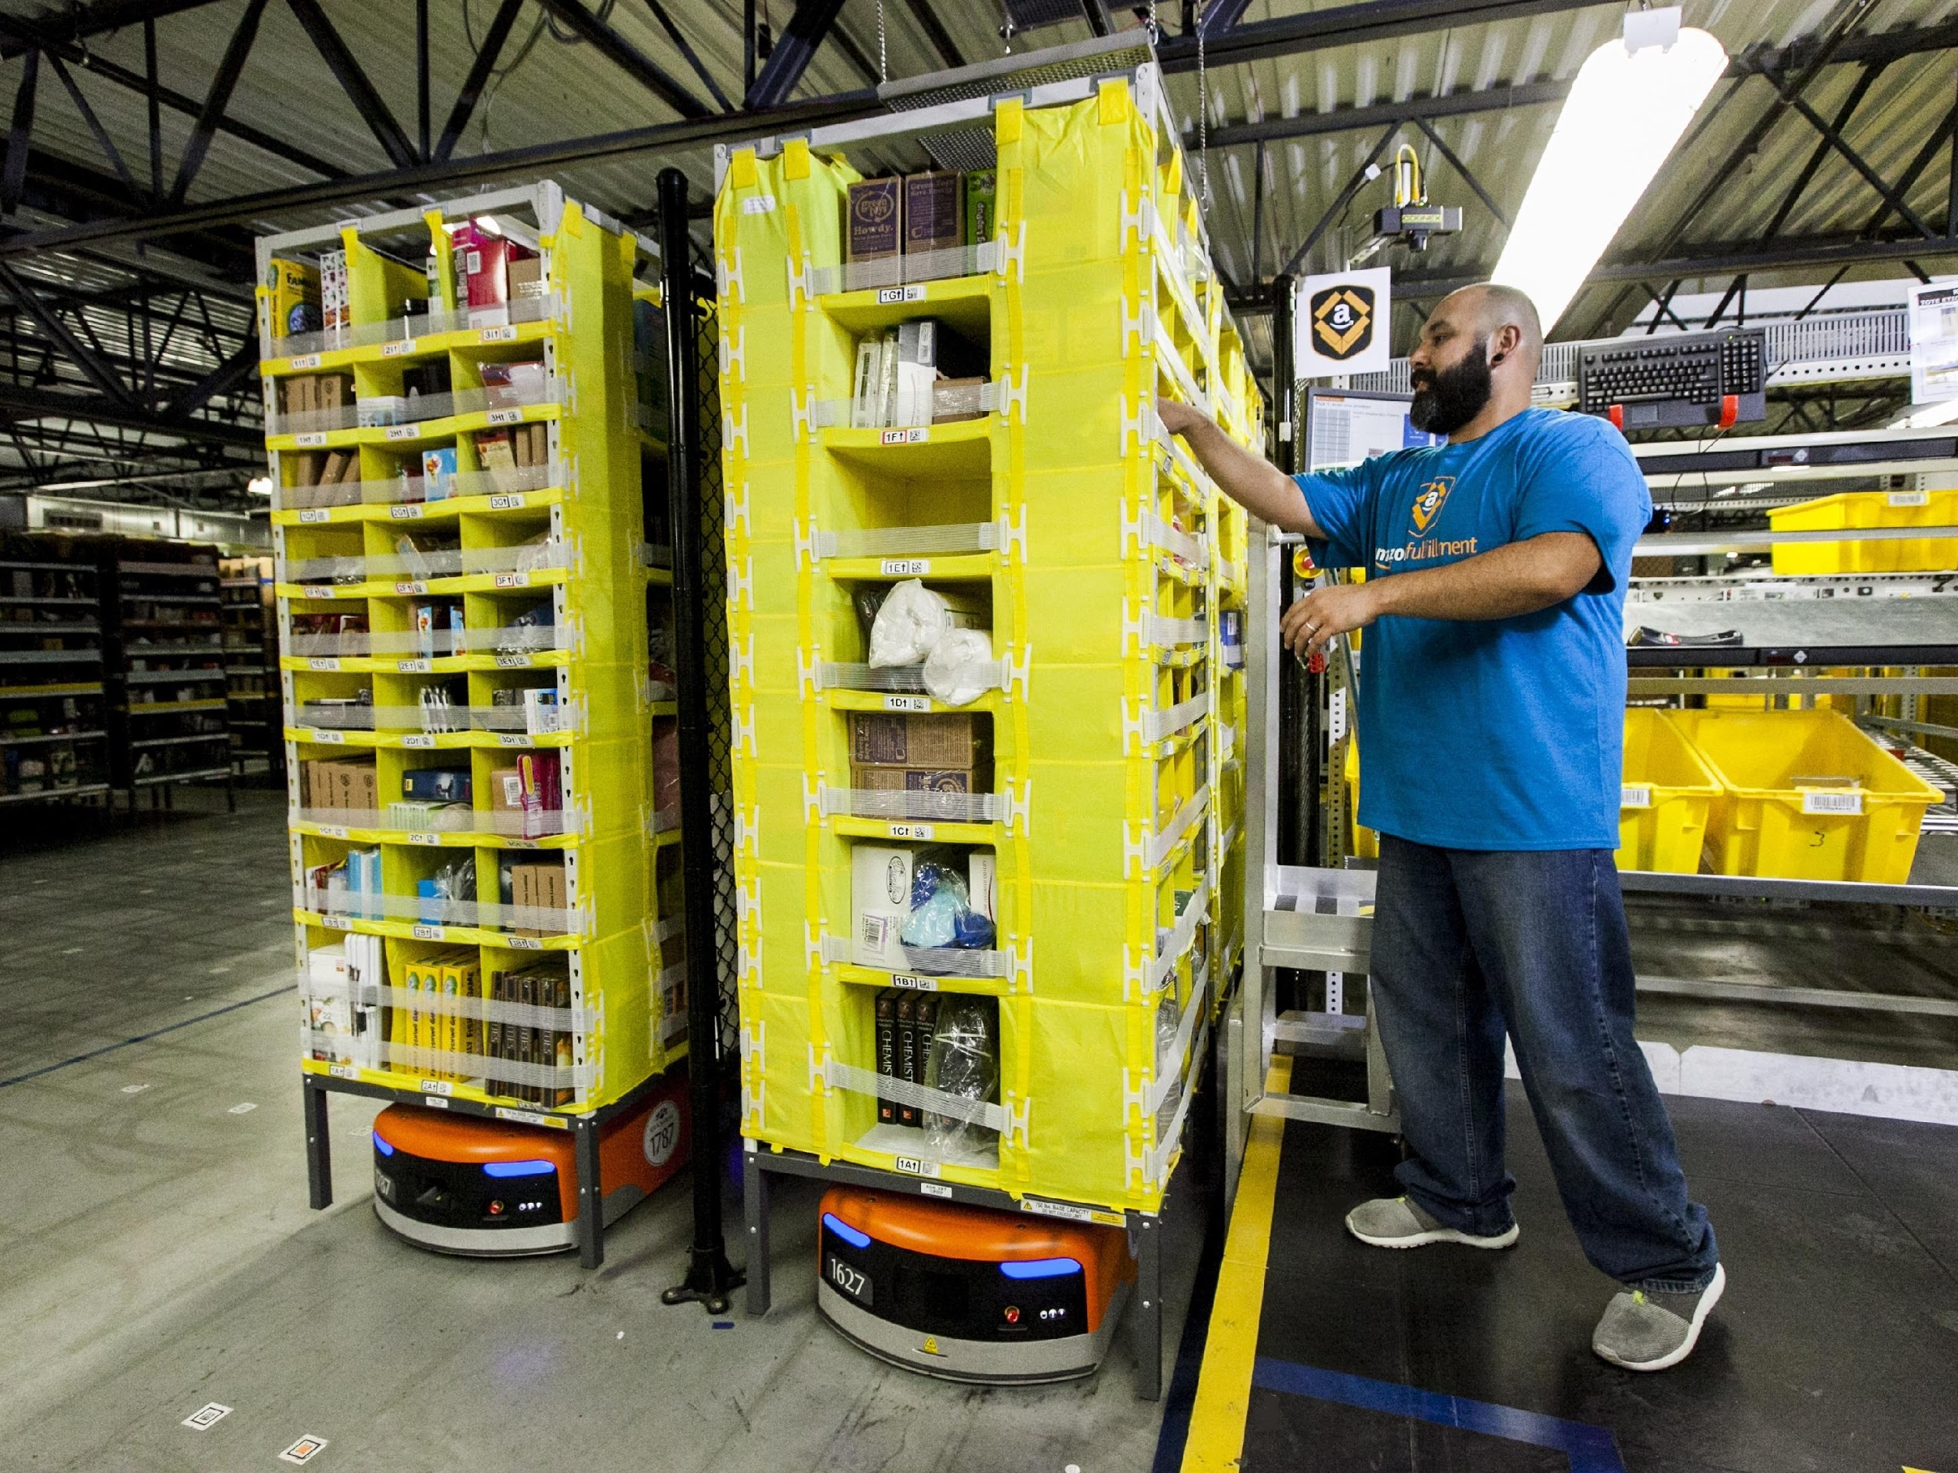
Literature Review
Current item retrieval
Locate bin
Find item within bin
Reach for the item
Place in the container
Prone to:
Wrong item retrieved
Inefficient picking order
November 20th, 2015

Slide 6
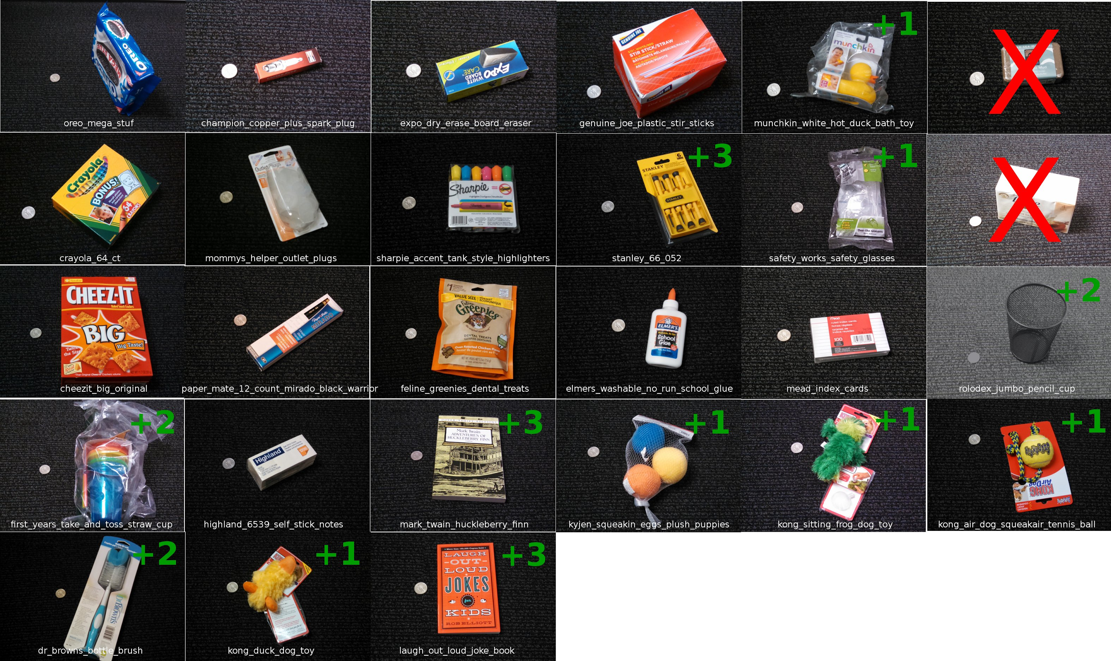
Literature Review
Amazon Picking Challenge
Items placed in multiple bins in a shelf
Number of items retrieved
Time of retrieval
Penalty for retrieval errors
(http://amazonpickingchallenge.org/details.shtml)
November 20th, 2015
Notes:
In order to solve this issue, Amazon created the AMAZON PICKING CHALLENGE. In this competition, items will be placed in multiple bins. Score will be calculated based on the number of correct items retrieved in the shortest time. And there’s a penalty for retrieving the wrong item, dropping an item, damaging an item.

Slide 7
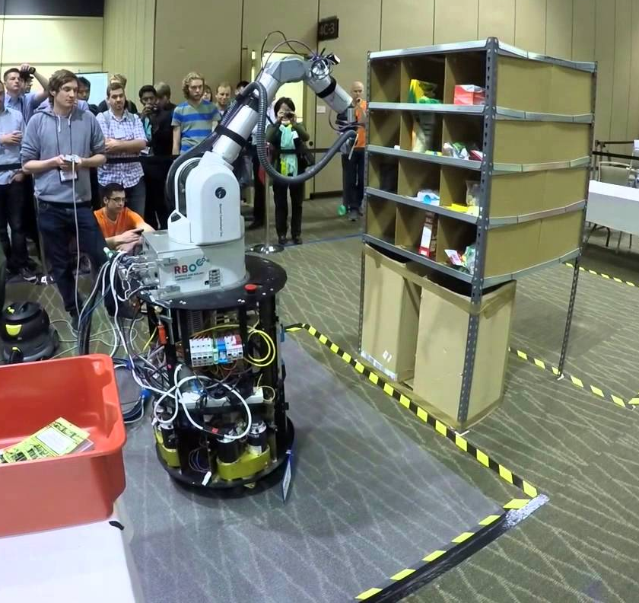
Literature Review
Team Berlin was the winner of the last competition. They were able to pick up 10 out of 12 items. However, they could not pick up metal mesh cup with their robot.
RBO Robot (Team Berlin)
November 20th, 2015
Notes:
This was last years winner of the Amazon Picking Challenge.
They used a robotic arm with a vacuum to suction up the items.
They were able to pick up 10 out of 12 items but found it difficult to pick up items such as a metal mesh cup.

Slide 8
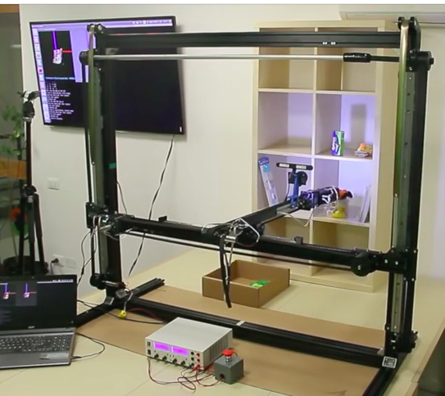
Literature Review
Centro Piaggio Team used an XYZ coordinate system with the Soft Hand gripper. The gripper could not fully grasp some items such as boxes laying flat.
Centro Piaggio Team
November 20th, 2015
Notes:
This is the system made by the Centro Piaggio team from Italy
They used a cartesian system
Their gripper resembled a human hand. However, it could not securely grasp some objects such as boxes laying down flat

Slide 9
System Uniqueness
The system has the following attributes:
Cartesian XYZ system
Combination of hand and vacuum gripper
Optimized retrieval sequence for highest possible score
November 20th, 2015
Notes:
What makes our system unique:
The XYZ frame will allow for accuracy and efficient movements to each bin
The gripper will have multiple degrees of freedom
We will use a combination of a traditional gripper and a suction cup to retrieve the objects
Retrieval sequence will follow an optimal path algorithm

Slide 10
System Design
Hardware
Software
User Interface
November 20th, 2015
Notes:
Now we are going to look at the system design of our automatic retrieval system.
It contains three main parts:
hardware
software
and UI
In the next slide, I will show you a video of how the system works

Slide 11
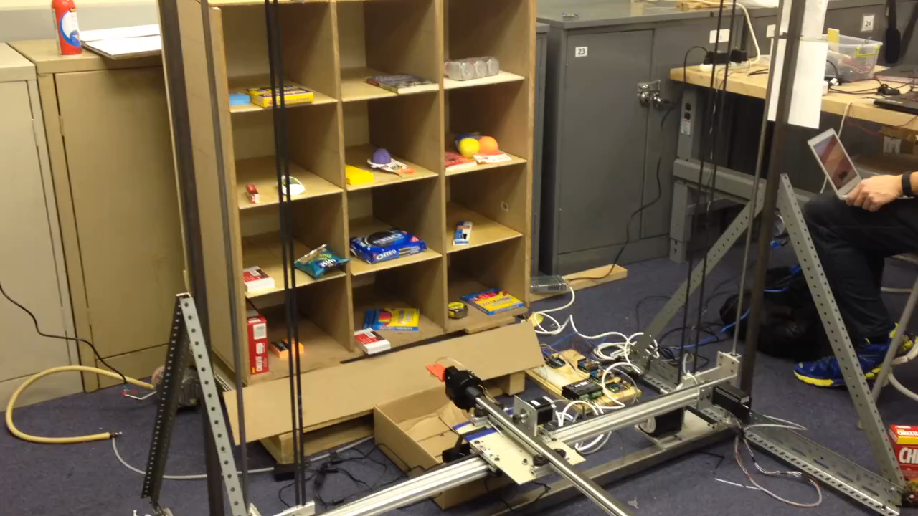
November 20th, 2015
Notes:
Bring the animation in a flash drive

Slide 12
System Design
Hardware
Software
User Interface
November 20th, 2015
Notes:
Next we are going look on the hardware part in more detail.

Slide 13
Hardware
XYZ frame
Robotic arm
Gripping mechanism
Kinect Sensor
November 20th, 2015
Notes:
The hardware of our system has 4 main components :
The XYZ frame
a Robotic Arm
A gripping mechanism
and a kinect sensor to perfrom image processing

Slide 14
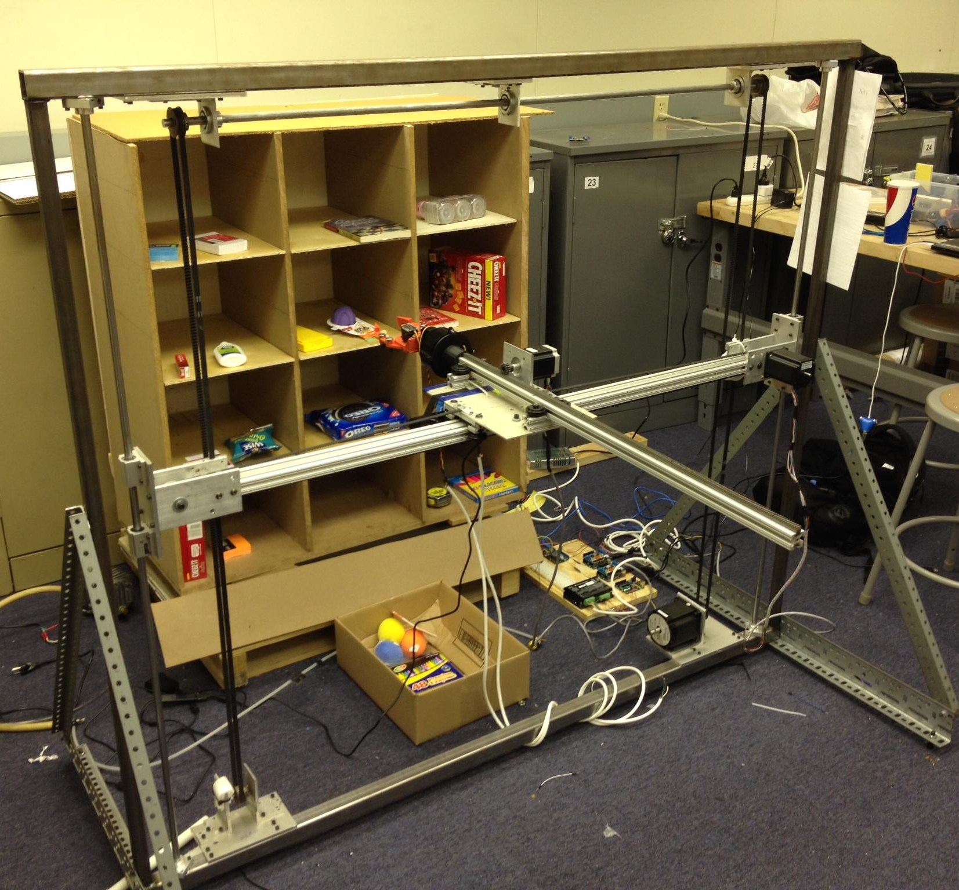
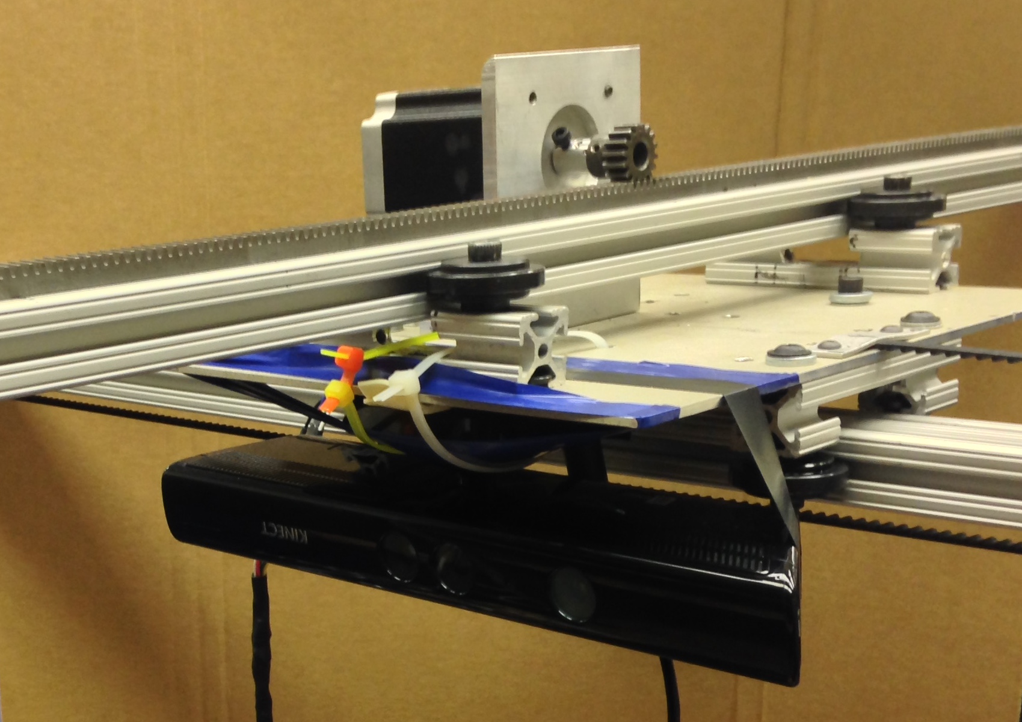
Z- Motor
X- Motor
Y- Motor
November 20th, 2015
Notes:
There are three motors that are responsible for the movements in the X Y and Z.
X and Y are using belt, and the Z is using a rack and pinion.
Also,
We mounted a kinect sensor on our system in order to detect the object we want to retrieve and find its location

Slide 15
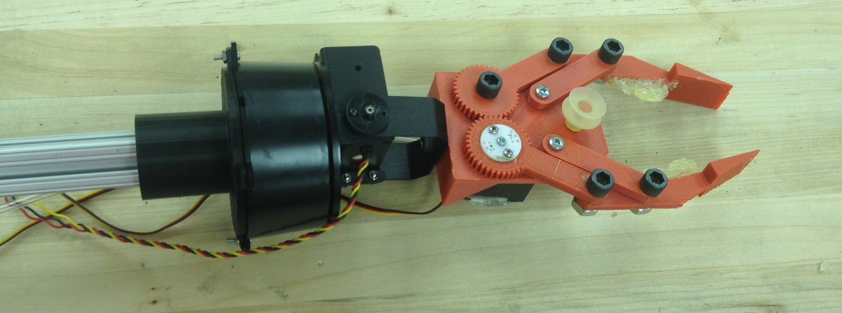
Gripping Mechanism
November 20th, 2015
Notes:
For our gripping mechanism, we will use the combination of a traditional gripper and a vacuum. We use this combination so that we can pick up different sizes of items

Slide 16
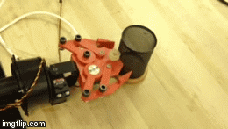
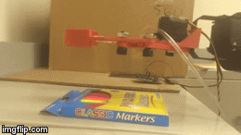
Gripping Mechanism
Gripper
Suction Cup
November 20th, 2015
Notes:
For our gripping mechanism, we will use the combination of a 2 finger gripper and a vacuum, which will be connected to a suction cup. We use this combination because of the different shapes, sizes and weights of the materials given.

Slide 17
System Design
Hardware
Software
User Interface
November 20th, 2015

Slide 18
Software
Order Processing
Optimized path algorithm/ Sequence of order calculation
Image Processing
Retrieval Process
November 20th, 2015

Slide 19
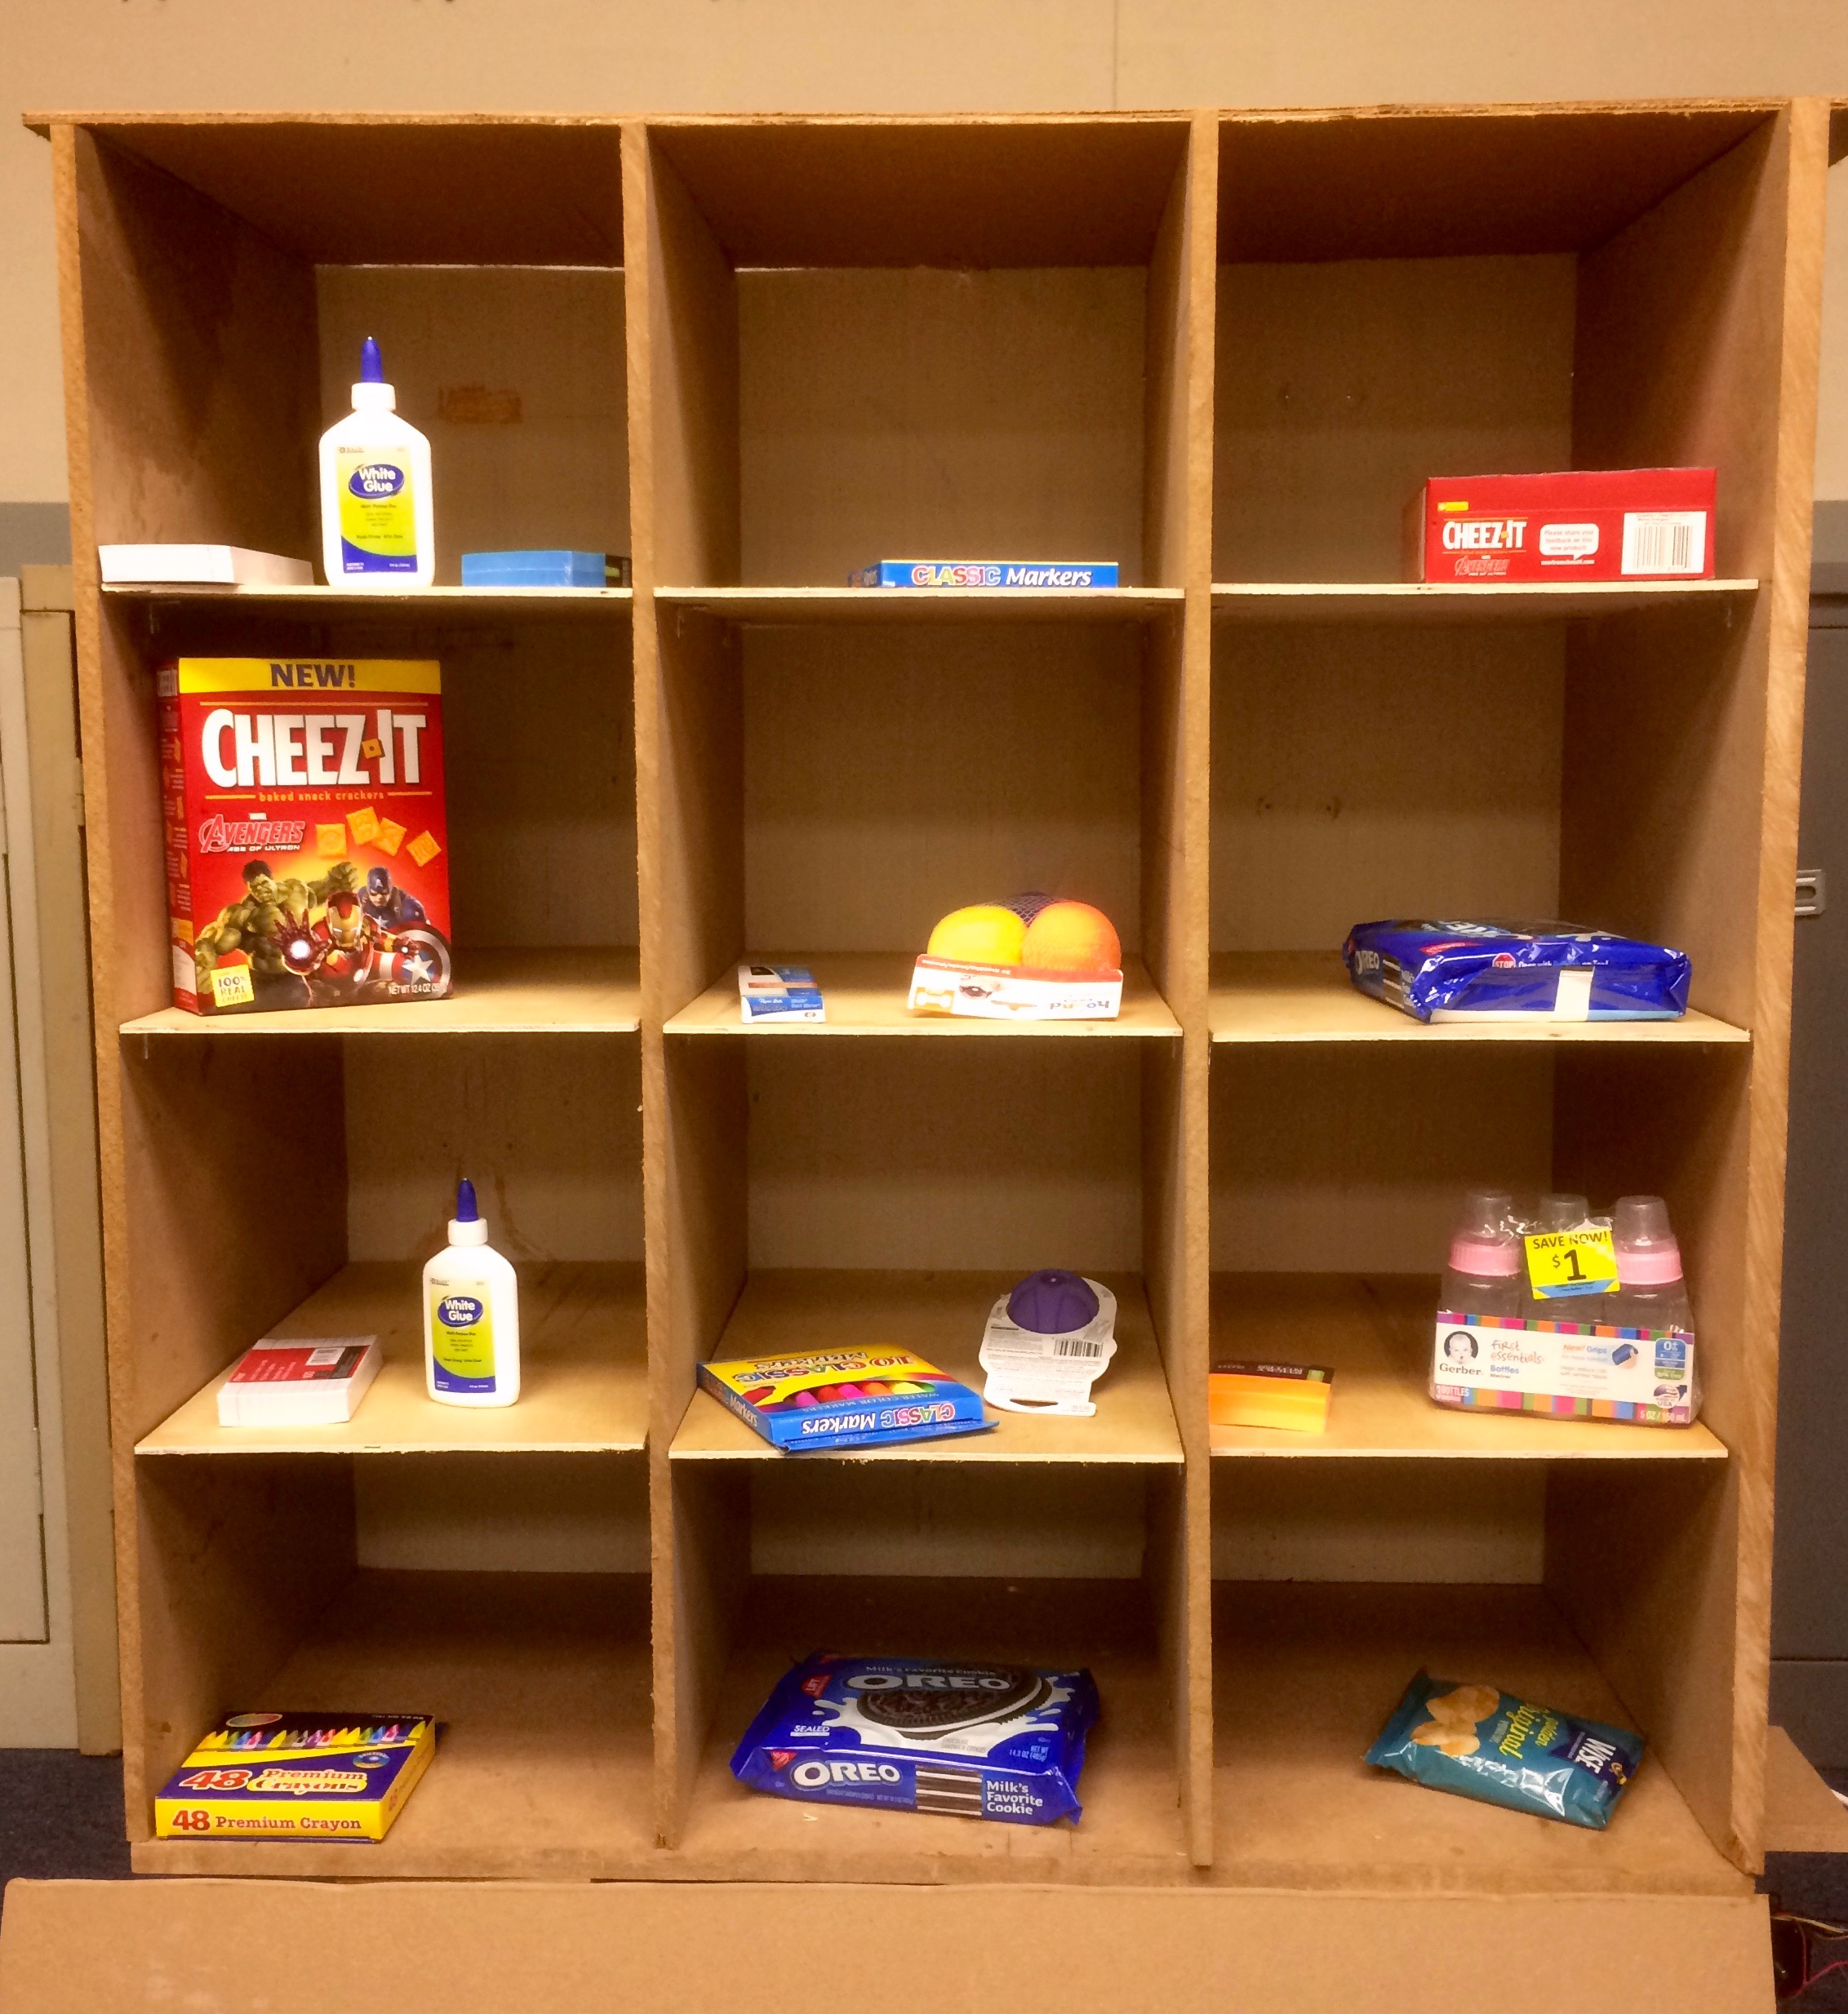
Points = 20
Time = 40s
Ratio = 2
Path Algorithm
A
Order sequence is determined by the ratio of processing time and points of each bin. Rank the ratio in an increasing order.
k
Points= 10
Time = 15s
Ratio = 1.5
November 20th, 2015
Notes:
for example.
Bin A -> 20 pts but takes 40 seconds
Bin K -> 10 pts but takes 15 seconds
Looking at the ratio, we can see bin A has the higher ratio
Reading the ratio:
BIN A 1.5 → it takes 1.5 seconds to get 1 point
BIN K 2 → it takes 2 seconds to get 1 point
so of course we want to go to Bin K first since it gives us higher points per minute.

Slide 20
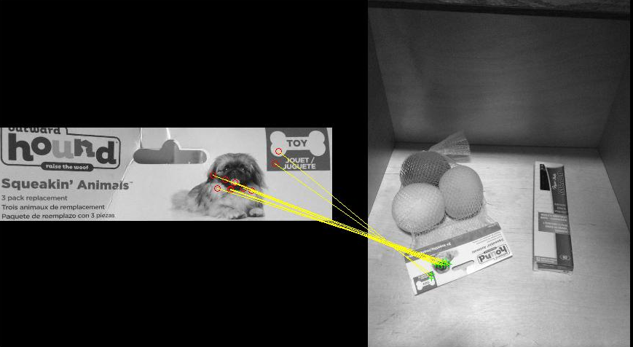
Software Object Detection
Shows match feature between the reference image and the picture of the item in the bin.
November 20th, 2015

Slide 21
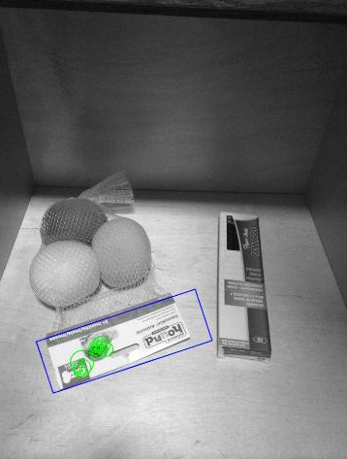
Software Object Detection
We find the location of each detected feature and determine the best coordinate to retrieve the item from.
November 20th, 2015
Notes:
Drew a box to isolate the item. the green points show the detected features, from there we take the average of each location to get one specific location.

Slide 22
Project Design
Hardware
Software
User Interface
November 20th, 2015

Slide 23
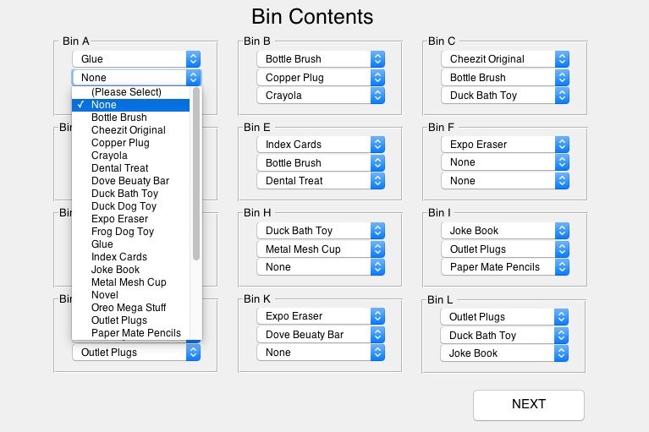
User Interface
November 20th, 2015

Slide 24
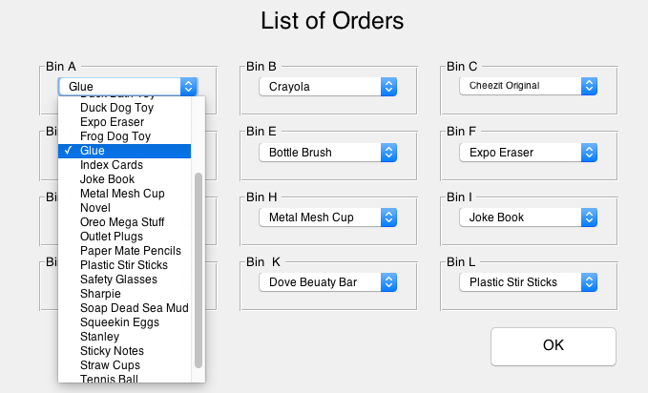
User Interface
November 20th, 2015

Slide 25
Conclusion
We designed and constructed a fully automatic order retrieval system that is able to retrieve items from shelves and place them into a container based on an optimal path algorithm.
November 20th, 2015
Notes:
MARI

Slide 26
Thank you! Questions?
November 20th, 2015

